Slide 1
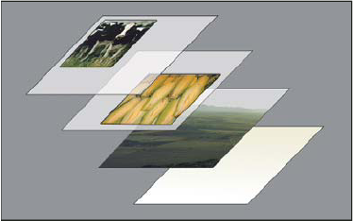
Graphical Enhancements
Graphical Enhancements
Continued
Photoshop layers representation - Transparent areas on a layer let you see layers below. All images Adobe Stock
Notes:
Photoshop layers representation
Transparent areas on a layer let you see layers below.

Slide 2
Layers, filters and other magic…
continues
3.1 Practice optimizing and combining images. (we continue from Week 5) We can review if necessary.
3.2 Show how layers, masks and selections can create new image compositions from multiple sources.
3.3 Make use of text and filters (Face-aware in Liquify) to develop collages, images and other required media.
3.4 Demonstrate and compare how contrast, levels, curves and saturation can be used to enhance an image.

Slide 3
Face-Aware Liquify
Face-Aware Liquify in Photoshop automatically detects facial features and adjusts them to enhance a portrait or add creative character to exaggerate a fun shot.
See the sample image, it exaggerates the man's surprised and happy expression by adjusting his eyes, mouth, and other facial features.

Slide 4
Face-Aware Liquify (cont’d)
In PSD > Menu>Filter>Liquify
Notes:
Changing the expresson of a man with Liquify-Face-Aware In PSD > Menu>Filter>Liquify

Slide 5
Other Selection tools – more magic Introduced in Photoshop 21.0 (November 2019 release)
The Select Subject command selects the prominent subject in an image in a single click. Powered by advanced machine learning technology it works like magic!
Select Subject is trained to identify a variety of objects in an image -people, animals, vehicles, toys, flying saucers and more. .
Quick Subject has a changeable paint brush tip. Quickly "paint" a selection using an adjustable round brush tip. Drag over the selection expands outward and automatically finds and follows defined edges in the image. Once selected see other options to add or subtract in the options bar.
The Magic Wand selects based on the colour of the pixels.

Slide 6
Object Selection tool – it’s so magical Introduced in Photoshop 21.0 (November 2019 release)
The Object Selection tool simplifies the process selecting a single object or part of an object in an image—people, cars, objects, furniture, pets, clothes, flying saucers, and more.
Simply draw a rectangular region or a lasso around the object, the Object Selection tool automatically selects the object inside the defined region. The tool works better on well-defined objects than on regions without contrast.
Select the Object Selection tool from the Tools panel.

Slide 7
Layer Adjustments
Add an adjustment layer in PSD
Select any of the following adjust through the panel and the properties panel to correct colour or the tone of an image on any layer.
Adjustment types
Curves
Hue and Saturation (H&S)
Levels
Colour Balance
Black & White
And more let’s take a look now!

